Slide 1
Ares’ Robotics Challenge Preliminary Design Review
By: Bruce Bell, Ryan wade, Rae Hong, Hiram saucedo

Slide 2
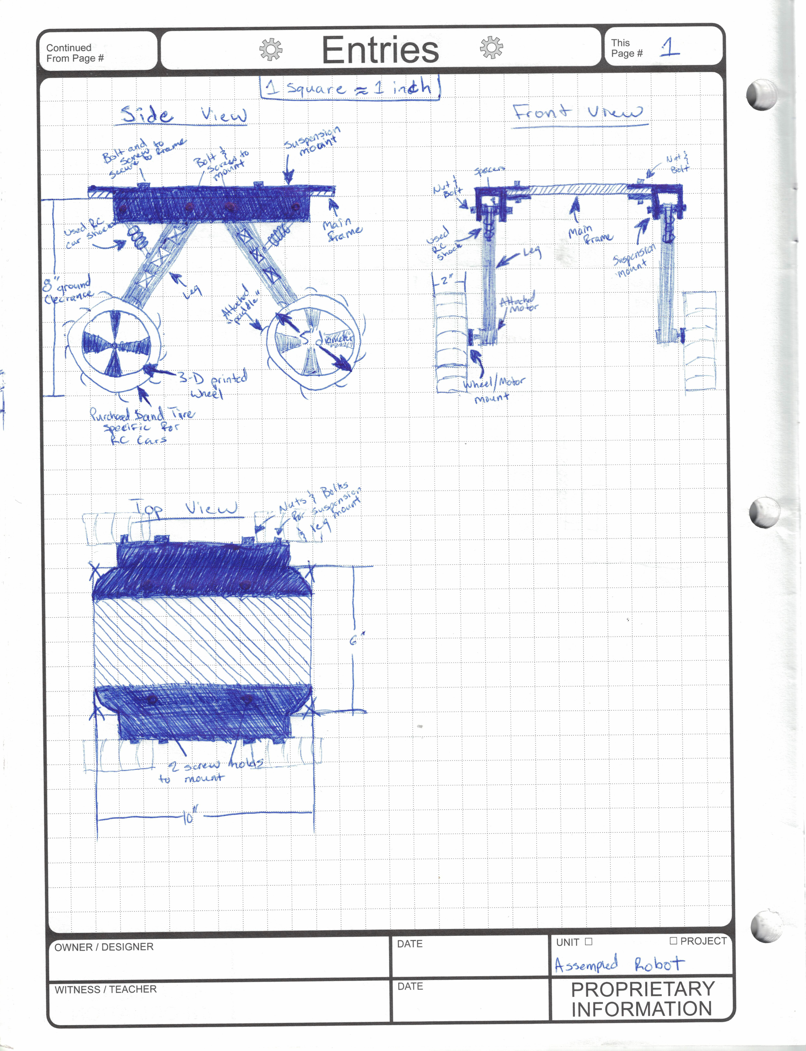

To the left is a sketched design of our robot. Shown is a side, top and front view of the proposed design. Most of the robot is going to be 3D printed, some bought and the other materials either made or refurbished.
The three major pieces that will be 3D printed are the legs, suspension/leg mount bracket, and the main frame. These pieces are the main structure of our design and will be secured with nuts and bolts.
The tires will be purchased from an RC car parts place. The tires are made of rubber and due to their paddle tread design will provide the most sand traction. The wheels will then be 3D printed to fit the tire. The design of the wheel will follow a standard car wheel design. The wheel will then be mounted to the motor and leg with a special motor mount attachment that will also be purchased.
The last key component is the suspension. We will use specific RC car suspension springs that are easily adjustable to allow for us to adjust and find which spring force is needed.

Slide 3
Shown here is a 3D modeled design of our robot. This deign does not yet include the actual suspension mount but contains other key features. Attached to the image are some notes that describe why we chose to design it the way we did.

Slide 4
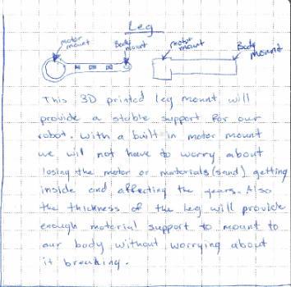
The pictures shown here are a break down of the leg design. The leg will be 3D printed and look identical to the image on the right. The leg design already considers the size of the motor and will allow for a perfect fit. The leg was built with the cross design to allow for structural stability and conservation of material. The leg was also built thick to reduce the risk of any of the mounting holes to break off. Our suspension spring will mount directly to the leg, though it is undecided how as of now.

Slide 5
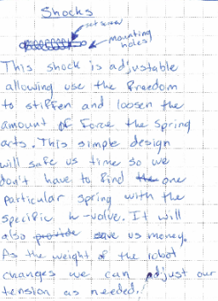
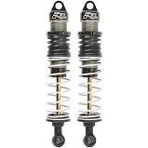
Shown here is our suspension springs. These will be reused from an old RC and will be incorporated and priced into our budget. The shocks will look similar to the image below and will be adjustable. The shocks being adjustable will be very useful as we add parts onto the robot. As the mass changes it will save time and money to simply adjust the spring tension as needed rather than repurchasing springs.

Slide 6
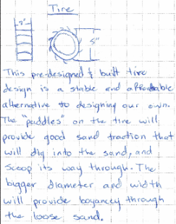
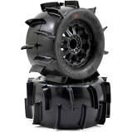
The tires we plan to purchase will have a similar design to the image to the bottom right without the wheel in the center. The tires will be made out of a stiff rubber which will allow for stability as well as flexibility. We plan for the tire diameter to be about 5 inches and the width to be about 2 inches. This will allow our robot to have more surface area in the sand and to maneuver over small obstacles with ease.

Slide 7
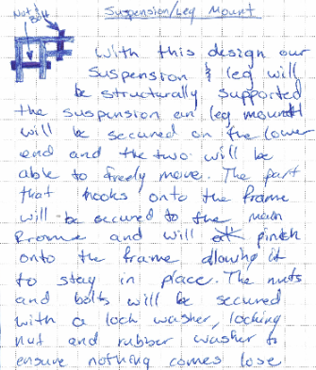
Attached above is a 3D model of the suspension/leg mount. This is what the 3D printed shape will look like. This design will be the main support of our robot. We plan to secure everything down with a few nuts, bolts and washers to ensure it does not move. To help keep things in place, a small triangular extrusion will lock into the frame of the robot. Before we print the design will not have any hard 90degree bends and will be filled in with a fillet to prevent from the parts snapping off.

Slide 8
This 3D image is what the main frame of our robot will look like. This piece will also be 3D printed and will look identical to the image above. The suspension/leg mount bracket will fit along the sides and will be secured down with nuts and bolts. The main frame design also has curved corners to math with the suspension/leg mount bracket. This will reduce the risk of out robot getting caught on something

Slide 9
To conclude
Most of our robot will be 3D printed to conserve cost and time as well as increase stability.
We have yet to design a protective roof for out robot frame but have many ideas to go off of.
We have designed and scaled off all of our robot and are just waiting for production

